Slide 1
Integrative Cancer Treatment
Mel Litman MD
Be’er Sheva, 2014

Slide 2
Incidence of Cancer in America CA,Cancer Journal for Clinicians, 2000
1900-3% of deaths from cancer
2000-24% of deaths from cancer
(surpassing heart disease as #1 cause)
28% increase in childhood cancers from 1950 to 1987

Slide 3
Breast Cancer Incidence in U.S. Surveillance Epidemiology and End Results SEER 2006
1940—50/100,000
2000—140/100,000
----------------------------------------------------------------
Between 1975 and 1994:
Cancer in women increased by 1.6% per year
Cancer in men increased by 1.5% per year
(Annual Review of Public Health 1999)

Slide 4
Cancer Incidence in Five Continents, 1982
Breast cancer among Chinese women living in China (age 45-75 yrs)—40-60/100,000
Breast cancer among Chinese women living in San Francisco(age 45-75 yrs)—150-160/100,000

Slide 5
The contribution of cytotoxic chemotherapy to 5-year survival in adult malignancies
Clin Oncol 2004
Review of clinical trials reporting 5 year survival benefit attributed to cytotoxic chemotherapy for 22 major adult malignancies in U.S. and Australia.
“The overall contribution of curative and adjuvant cytotoxic chemotherapy to 5-yr survival in adults was estimated to be 2.3% in Australia and 2.1% in the USA…it is clear that cytotoxic chemotherapy only makes a minor contribution to cancer survival.”

Slide 6
Serum B-vitamins and risk of lung cancer
JAMA 2010
Survey of 385,000 people in Europe.
High levels of B6 or Folate or Methionine associated with a 50% or greater reduction in lung cancer.
Greater reduction if all were at good levels.

Slide 7
Dietary supplements and mortality rate in older women
Arch Intern Med 2011 The Iowa Women’s Health
Study
Reported: “Multivitamins increase deaths in older women”
Study findings: B-complex vitamins associated with 7% decrease in mortality.
Vit C associated with a 4% decrease in mortality.
Vit D associated with a 8% decrease in mortality. Various minerals associated with a decrease in mortality.

Slide 8
Vitamin/mineral supplementation and cancer, cardiovascular, and all-cause mortality in a German prospective cohort (EPIC-Heidelberg)
European Journal of Nutrition 2012
23,943 participants followed for average of 11 years.
Baseline users of antioxidant supplements had a significantly reduced risk of cancer mortality (48% less)

Slide 9
EPIC-Heidelberg (cont.)
All cause mortality 42% less compared to never-users.
But—non-users at baseline who started supplements during the follow-up period had increased risks of cancer and all-cause mortality.
Authors suggest a “sick-user effect” eg. People who start supplements ‘because’ they become ill.

Slide 10
Multivitamins in the Prevention of Cancer in Men. The Physicians’ Health Study II Randomized Control Trial
JAMA 2012
Large randomised, double-blind, placebo-controlled trial.
14,641 male US physicians 50 yrs or older
Followed for average of 11 years. Randomized to either multivitamin or placebo.
Statistically significant reduction of about 8% in total cancer incidence in men taking daily multivitamin.

Slide 11
Megadose vitamin in bladder cancer
J Urol 1994
65 patients with bladder cancer randomized to either RDA multivitamin or RDA vit + Vit A 40,000 iu, B6 100 mg, Vit C 2000 mg, Vit E 400 iu, Zinc 90 mg
After 10 months—80% of RDA supplement group relapsed. ---40% of “megavitamin” group relapsed.

Slide 12
Antioxidants and breast cancer risk-a population-based case-control study in Canada
BMC Cancer, 2011
Comparison of antioxidant intake of 10 yrs or more in 2,362 cases with breast cancer compared to 2,496 controls
Results: Breast cancer risk in premenopausal women reduced by 54% in women using zinc supplementation. Breast cancer risk in postmenopausal women reduced 26% with multivitamin, 42% with beta-carotene, 21% with vitamin C, 25% with vitamin E, and 53% with zinc

Slide 13
Vitamin D for cancer prevention:global perspective.
Ann Epidemiol 2009
Based on observational studies and a randomized clinical trial.
Expected effect of raising year-round serum Vit D to 40-60 ng/dl—reduced case-fatality rate of patients with breast, colorectal, prostate cancer by half. Generally needing 4000-5000 iu per day to achieve levels.

Slide 14
Lifestyle influences on cancer regression
Int J Biosoc Res, 1988
200 people reporting “spontaneous regression” in cancer : 87% made major dietary changes, 65% used nutritional supplements, 55% used a form of detoxification

Slide 15
Shanghai breast cancer survival study
Cancer Epidemiology, Biomarkers, & Prevention, 2011
Prospective cohort study of women receiving conventional cancer treatment +/- nutritional supplements in the 1st 6 months after diagnosis
4877 women aged 20-75 yrs with breast cancer
Women who used vit E, vit C, or multivitamins had 18% reduced risk of death and 22% decreased risk of recurrence

Slide 16
San Antonio Breast Cancer Symposium, Dec 2010
2239 women diagnosed with early stage breast cancer
Results: women who had continually taken multivitamins with minerals before diagnosis and continued after were 31% less likely to have a recurrence; 47% less likely to die of breast cancer; and 27% less likely to die of any cause
Less clear benefit if women took only vitamins without minerals

Slide 17
Fifteen-year effects of H pylori, garlic, and vitamin treatments on gastric cancer incidence and mortality
J Natl Can Inst 2012
3365 subjects randomized control trial
Approximately 50% reduction in deaths from gastric and esophageal cancer in those taking “vitamin treatment” (vit C, E, selenium)

Slide 18
Treatment with antioxidant and other nutrients in combination with chemotherapy and irradiation in patients with lung cancer
Anticancer Res, 1992
18 patients with small cell lung cancer receiving standard therapy, given multiple high-dose vitamins and minerals
Expected survival at 30 months—1%
8/18 (40%) alive at 6 yrs
Improved chances if starting antioxidants earlier

Slide 19
Chemotherapy alone vs chemotherapy plus high dose multiple antioxidants in patients with advanced non small cell lung cancer
J Am Coll Nutr 2005
136 patients with stage 3-4 NSCLC randomized to chemotherapy or chemo plus oral Vit C, Vit E, beta-carotene.
Results: -chemotherapy alone RR 33%, no CR
-survival at 1 yr 32.9%
-chemo + antioxidants RR 37%, CR in 2 patients -survival at 1 yr 39.1%

Slide 20
Chemoprevention of DNBA-induced mammary carcinogenesis in rats
Jpn J Ca Res, 1990
Rats given DNBA (carcinogen)—100% developed cancer
Added nutrients—selenium, magnesium, vit C, vit A alone or in combinations
Results: 1 nutrient-about 50% decrease in cancer
2 nutrients-about 70% decrease
3 nutrients-about 80% decrease
4 nutrients-about 88% decrease

Slide 21
Vit C and K3
Cancer, 1989
Each vitamin shown to have anti-cancer activity individually on cultured breast cancer cell lines
Combined vitamins are effective at 10-50 times lower dosages

Slide 22
The effect if vitamin E and beta carotene on the incidence of lung cancer and other cancers in male smokers
NEJM, 1994
Alpha tocopherol (50mg) or beta carotene or both or placebo given to 29,133 male smokers
Results: no effect of vit E
18% increase in lung cancer in beta carotene group

Slide 23
Antioxidants/Free Radicals
Over 200 epidemiology studies showing fruits &vegetables (high antioxidants) lower cancer risk.
11 studies showing beta carotene protective against lung cancer
Research showing isolated antioxidants can become free radicals in environment high in free radicals eg. Smoking
Antioxidants work as ‘teams’ physiologically

Slide 24
Antioxidant vitamins supplementation and mortality: a randomized trial in head and neck cancer patients
Int J Cancer 2006
Head and neck cancer patients treated with radiation-given either synthetic beta carotene 30mg (discontinued during study) and/or alpha-tocopherol (vit E) 400 iu or placebo
Results: 40% higher early recurrence of cancer in supplement group
No difference between the groups after 8 yrs of follow-up

Slide 25
Interaction between antioxidant vitamin supplementation and cigarette smoking during radiation therapy in relation to long-term effects on recurrence and mortality: A randomized trial among head and neck cancer patients
Int J Cancer, 2007
Increased cancer recurrence only occurred in patients smoking during their radiation treatments.
No increases at all in those not smoking.
Significant decreased side effects (tissue damage) from the radiation in antioxidant group.

Slide 26
Rationale for using high-dose multiple antioxidants as an adjunct to radiation therapy and chemotherapy
J Nutr, 2004, Prasad
“Laboratory data show that antioxidants protect cancer cells when administered only one at a time at low doses”
“A mixture of vit A, E succinate, vit C, and carotenoids produces about 50% proliferation inhibition in human melanoma cells in culture at doses that do not reduce proliferation when used individually. Doubling only the dose of vit C in the mixture causes about 90% proliferation inhibition”

Slide 27
Prasad, 2004 (cont)
“Vit A and beta carotene at high doses administered daily before radiation and during the entire observation period produces more than 90% cure rate in mice with transplanted breast adenocarcinoma; whereas treatment with radiation alone or antioxidant alone is ineffective

Slide 28
Antioxidants and other nutrients do not interfere with chemotherapy or radiation therapy and can increase kill and increase survival
Alt Ther Health Med, 2007, Simone C
280 peer reviewed studies
50 human clinical trials (various nutrients in combination with standard treatments)
“Furthermore, they enhance the killing of therapeutic modalities for cancer, decrease their side effects and protect normal tissue”

Slide 29
Impact of antioxidant supplementation on chemotherapeutic efficacy: A systematic review of the evidence from randomised controlled trials
Cancer Treat Rev, 2007, Block K
Reviewed 845 peer-reviewed articles
19 clinical trials meeting strict criteria
Conclusion: None of the trials reported evidence of significant decreases in efficacy from antioxidant supplementation during chemotherapy. Many studies showed increased survival times, increased tumor responses or both as well as fewer toxicities than controls.

Slide 30
Neuroprotective effect of glutathione on oxaplatin-based chemotherapy in advanced colorectal cancer
J Clin Oncol 2002
52 patients with advanced colorectal cancer randomized to receive oxaplatin with IV glutathione or saline pretreatment
Results: neuropathy occurred in 42% of control group and 27% of glutathione group

Slide 31
Neuroprotective effect of vit E supplementation in patients treated with cisplatin chemotherapy
J Clin Oncol
27 patients with various cancers treated with cisplatin alone or with added vit E 300 iu
Results: more than 85% of cisplatin group developed neuropathy, 31% of vit E group developed nerve damage. Severity of damage was also lower in vit E group.

Slide 32
Antioxidants and chemotherapy toxicity
A number of other clinical trials with various antioxidants showing decreases in neurotoxity, cardiotoxicity, lung damage, mucositis, bone marrow toxicity
No trials reporting decreased efficacy of chemotherapy

Slide 33
The use of antioxidants with first-line chemotherapy in two cases of ovarian cancer
J Am Coll Nutr 2003
2 cases of advanced ovarian cancer (stage 3)
Had standard chemotherapy
Taking high dose oral antioxidants
Given intravenous vitamin C twice per wk
Both patients showing no evidence of disease over 3 yrs later

Slide 34
Intravenously administered vitamin C as cancer therapy: three cases
CMAJ 2006
3 cases of confirmed cancer treated with intravenous vit C and supplements (declined chemotherapy)
Showed unexpectedly long survival times, with one apparent cure

Slide 35
Intravenous vitamin C administration improves quality of life in breast cancer patients during chemo/radiotherapy and aftercare
In Vivo 2011
125 breast cancer patients. All received standard care.
53 received additional IVC for at least 4 wks
Results: IVC administration resulted in a signif reduction in symptoms of nausea, loss of appetite, fatigue, depression, sleep disorders, dizziness, hemorrhagic diathesis

Slide 36
Vitamin C antagonizes the cytotoxic effects of antineoplastic drugs
Cancer Res 2008
Effect of pre-treatment with dehydroascorbic acid (oxidized ascorbate) on the cytotoxicity of doxorubicin, cisplatin, vincristine, methotrexate, and imatinib on a cell line of leukemia and lymphoma
Showed a decrease in cytotoxicity of all drugs tested

Slide 37
Ascorbate exerts anti-proliferative effects through cell cycle inhibition and sensitizes tumor cells towards cytostatic drugs
Cancer ChemotherPharmacol 2011
Investigating the effects of both ascorbate and dehydroascorbate, with and without various chemotherapeutic drugs, on cancer cell lines.
Conclusions: “higher therapeutic efficacy of ascorbate over dihydro-ascorbate for various cell lines”
“ascorbate shows therapeutic efficacy in tumor cells”

Slide 38
Cancer ChemotherPharmacol 2011 (cont)
“in addition to the induction of apoptosis, also include an antiproliferative effect by inducing cell cycle arrest”
“Futhermore, ascorbate treatment specifically enhances the cytostatic potency of certain chemotherapeutics (neutral effect on others), which implicates therapeutic benefit during tumor treatment”

Slide 39
Vitamin C and survival among women with breast cancer: a meta-analysis
Eur J Cancer 2014
Meta-analysis of 10 prospective studies using either vit c supplement or increased dietary sources, post-diagnosis—included over 17,000 women with breast cancer.
Results: 19% decreased total deaths with vit c supplement
27% decreased deaths with dietary increase of 100 mg vit c

Slide 40
High-Dose Parenteral Ascorbate Enhanced Chemosensitivity of Ovarian Cancer and Reduced Toxicity of Chemotherapy
Sci Transl Med 2014
“Combination of parenteral ascorbate with the conventional chemotherapeutic agents carboplatin and paclitaxel synergistically inhibited ovarian cancer in mouse models and reduced chemotherapy-associated toxocity in patients with ovarian cancer”…”no toxicity to liver, kidney or spleen”

Slide 41
“Evidence-based Medicine
Story reported in New Zealand in 2010 of farmer with swine flu. Hospitalized, in coma, considered terminal. Family insisted on trying IV vit C as last hope. Physicians at hospital refused on the grounds that it was unscientific and irrational (“no evidence”).
Family went to court to allow treatment and won. Patient given vit C and made a full recovery.

Slide 42
Guidelines for the Provision and Assessment of Nutrition Support Therapy in the Adult Critically Ill Patient
Society of Critical Care Medicine (SCCM) and
American Society for Parental and Enteral Nutrition (ASPEN)
2009 recommendation that high-dose intravenous antioxidant therapy for all critically ill patients.
Based on systematic review of studies which included use of IV vit C 1gm every 8 hrs and other antioxidants showing improved clinical outcomes of critically ill patients.

Slide 43
Vitamin C Deficiency in a University Teaching Hospital
JAmCollNutr 2007
60% of hospitalized patients in a Canadian teaching hospital had a sub-normal vit C concentration in their blood shortly after admission
Level remained unimproved after an average of 17 days in hospital
“Conclusion: Vitamin C deficiency is prevalent and sustained in patients in a Canadian teaching hospital”

Slide 44
Tumors:Wounds that do not heal: Similarities between tumor stroma generation and wound healing
NEJM, 1986
Cancer uses normal mechanisms of healing an injury in an abnormal way.
Creates inflammation, growth factors, enzymes, angiogenic chemicals
But without an “off switch”

Slide 45
The Cancer Terrain
The body’s influence on tumor promotion:
Increased oxidation—free radicals
Inflammation
Immune system failure
Glycemia—high blood sugar, high insulin (insulin resistance)
Stress hormones—immune suppression
--inflammation

Slide 46
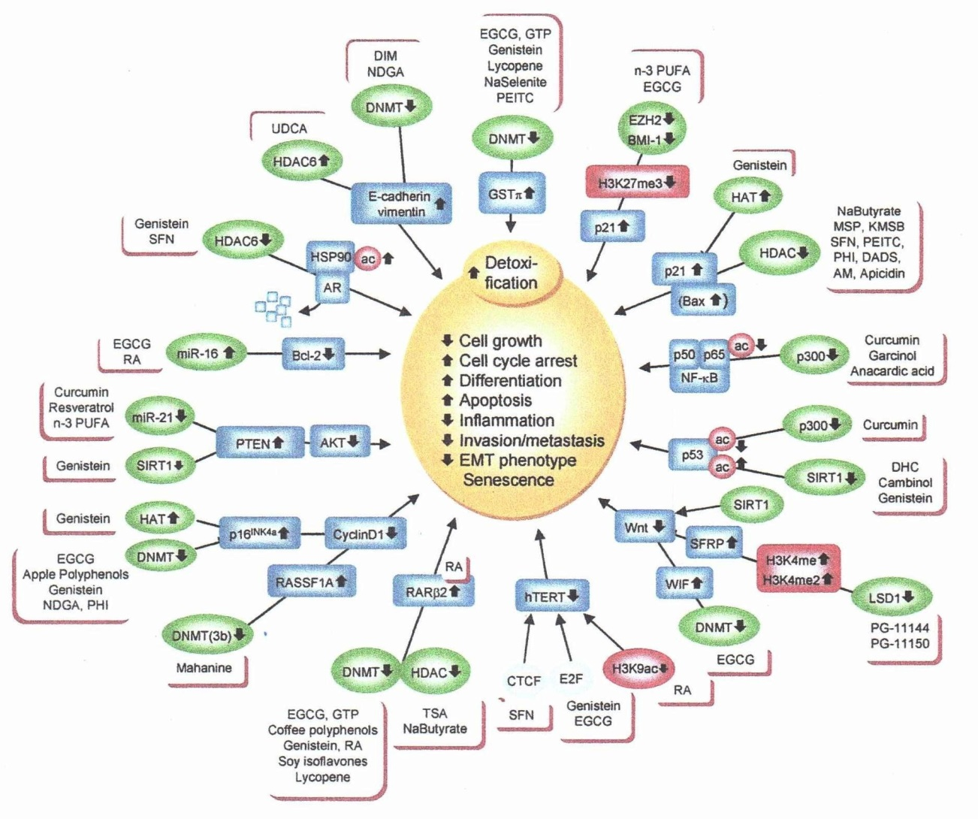
Mechanisms Targeted by Chemopreventive Agents

Slide 47
Pro-Cancer Events
John Boik
Induction of genetic instability-allowing mutations
Abnormal expression of genes.
Abnormal signal transduction.
Abnormal cell-to-cell communication.
Induction of angiogenesis
Invasion and metastasis.
Immune evasion.

Slide 48
Therapeutic Goals
Reduce genetic instability eg. Oxidative stress
Inhibit abnormal expression of genes—modify transcription factors that turn genes on and off.
Inhibit abnormal signal transduction—block signals giving undesired messages to the cell eg. For proliferation.
Encourage normal cell-to-cell communication eg. Improve response of cancer cell to regulating signals from normal cells.
Inhibit angiogenesis—normalize factors that stimulate angiogenesis
Inhibit invasion and metastasis—inhibit enzymes that digest tissue and that allow cancer cells to move.
Increase immune response—increase/activate immune cells and decrease ability of cancer cells to ‘hide’.

Slide 49
Genetic Damage and Instability
Natural compounds that protect DNA from damage and mutations:
Hundreds or thousands of compounds in nature—antioxidant vitamins (eg. Vit C, VitE) and minerals (eg selenium,zinc), bioflavenoids (eg. Curcumin, EGCG, Resveratrol), detoxificants (eg. Alpha-lipoic acid, NAC )

Slide 50
Cancer as a metabolic disease
Nutrition & Metabolism 2010
“Emerging evidence indicates that impaired cellular energy metabolism is the defining characteristic of nearly all cancers regardless of cell origin”…”general hypothesis that genomic instability and essentially all hallmarks of cancer including aerobic glycolysis (Warburg effect) can be linked to impaired mitochondrial function and energy metabolism”

Slide 51
Is there a role for carbohydrate restriction in the treatment and prevention of cancer
Nutrition & Metabolism 2011
“Most malignant cells depend on steady glucose availability for their energy and biomass generating demends and are not able to metabolize significant amounts of fatty acids or ketone bodies due to mitochondrial dysfunction”

Slide 52
Carbohydrate restriction (cont.)
“High insulin and IGF-1 levels resulting from chronic ingestion of carbohydrate-rich Western diet meals can directly promote tumor proliferation”
“Ketone bodies that are elevated when insulin and blood glucose levels are low have been found to negatively affect proliferation”
Currently multiple clinical trials in the use of a ketogenic diet with various combinations of treatments

Slide 53
Abnormal Expression of Genes
Oncogenes (encourage cell proliferation and growth) and cancer suppressor genes (decrease growth, increase differentiation/maturation, promote apoptosis-normal cell death)
Natural compounds that can help to normalize gene expression--turning off and on of appropriate genes: Vit C, Vit E, Melatonin, Vit D, Curcumin, EGCG, Genistein, Resveratrol, Selenium, Quercetin

Slide 54
Signal Transduction
‘Messenger chemicals’ giving signals to cells that regulate growth.
Natural compounds helping to normalize inappropriate signals: Boswellia, Curcumin, EPA &DHA, Various flavenoids, Garlic, Melatonin, Parthenolide,Resveratrol, Vit E

Slide 55
Cell-to-cell Communication
Cancer cells can act ‘independently’ from neighboring cells and the body as a whole, ‘ignore’ feedback/communication from the ‘cooperative’ cells of the healthy body
Natural compounds that can enhance communication: Vit A, Genistein, EGCG, Melatonin, Resveratrol, Selenium, Vit D

Slide 56
Invasion and Metastasis
One of the defining characteristics of cancer.
Utilizing enzymes to facilitate.
Natural compounds that reduce activity of various involved enzymes (eg. Collagenases, hyaluronidase, heparinase): Boswellia, Centella asiatica (gotu kola), Proanthocyanidins, Resveratrol, Vit C, Vit A, Curcumin, EGCG, EPA
Inhibiting cell migration: Vit D, EPA/DHA, Genistein, Melatonin, Ginseng

Slide 57
Immune Surveillance
Natural compounds enhancing immune system function or decreasing immune evasion: various mushrooms (eg shiitake, maitake, etc), Zinc, Selenium, Glutathione, Vit C, Melatonin, Enzymes (eg bromelain, pancreatic)

Slide 58
Blood Sugar and Insulin Regulation
Tumors consume glucose at a rate of 10-50 times higher than normal tissue
Diabetics more prone to cancer of breast, prostate, colon, liver, and pancreas.
Insulin (and IGF-1) stimulate growth of many cancers.
Approaches to help reduce blood sugar and insulin levels: low refined carbohydrate diet, vit D, Berberine, Cinnamon, Chromium, Coffeeberry extract, Holy basil

Slide 59
Example Nutritional Support Treatment Plan
Vit D 5000 iu
Vit A 10,000-20,000 iu
Vit K2 45 mg
Vit E (tocotrienols)
Omega-3 (fish oil) 2000 mg (EPA+DHA)
Curcumin (enhanced absorption) 500-800 mg tid
Green tea (EGCG 300-350 mg tid)
Resveratrol 250-300 mg, Berberine 500 mg bid
Foods: Brazil nuts (selenium), Brocolli sprouts (sulforaphane), Seaweed

Slide 60
Therapeutic Goals
Modify/correct as many cancer promoting factors as possible.
The more mechanisms that can be influenced simultaneously, the better the expected effect.
Utilize synergism (“teams”)—increased effectiveness at lower doses with combinations of compounds with related activity.
Minimize toxicity to healthy cells from cytotoxic treatments.

